Slide 1

Comp 401 Animation, Threads, Command Objects
Instructor: Prasun Dewan

Slide 2
Prerequisite
Animation MVC

Slide 3
Topics
Animation
Command Object
Object representing an action invocation such as “Do your homework”.
Threads
Support non blocking action invocation.

Slide 4
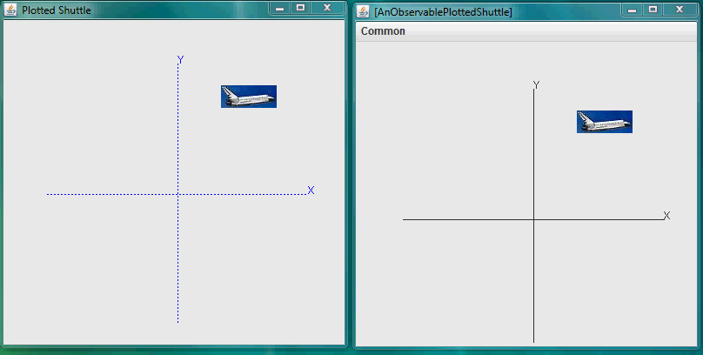
Animation and MVC

Slide 5
AnimateFromOrigin
public void animateFromOrigin(PlottedShuttle shuttle,
int animationStep, int animationPauseTime) {
int originalX = shuttle.getShuttleX();
int originalY = shuttle.getShuttleY();
int curX = 0;
int curY = 0;
shuttle.setShuttleX(curX);
shuttle.setShuttleY(curY);
animateYFromOrigin(shuttle, animationStep,
animationPauseTime, curY, originalY);
animateXFromOrigin(shuttle, animationStep,
animationPauseTime, curX, originalX);
}

Slide 6
Animation in Y Direction
protected void animateYFromOrigin(PlottedShuttle shuttle,
int animationStep, int animationPauseTime,
int startY, int endY) {
// make sure we don’t go past final Y position
while (startY < endY) {
ThreadSupport.sleep(animationPauseTime);
startY += animationStep;
shuttle.setShuttleY(startY);
}
// move to destination Y position
shuttle.setShuttleY(endY);
}

Slide 7
Observable Architecture
AnObservable
PlottedShuttle
Component
setShuttleX(Y)()
repaint()
paint()
AShuttleAnimator
animateFromOrigin
Main Class
main

Slide 8
Animation and MVC

Slide 9
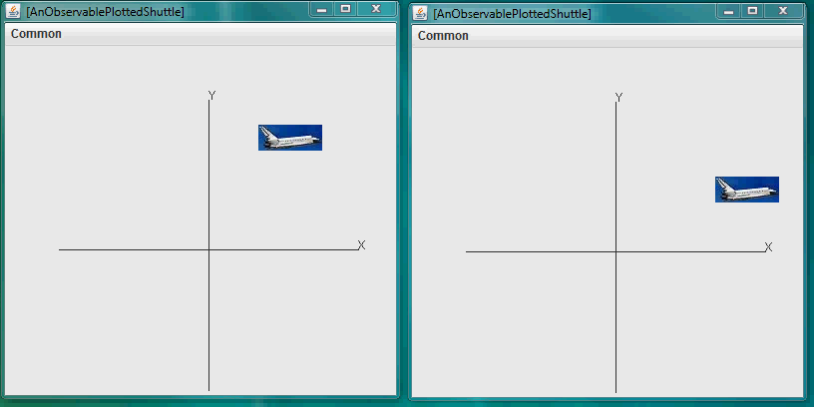
Two Independent Animations

Slide 10
Independent Animations?
public static void main(String[] args) {
PlottedShuttle shuttle1 = new AnObservablePlottedShuttle(50, 100);
OEFrame oeFrame1 = ObjectEditor.edit(shuttle1);
oeFrame1.hideMainPanel();
oeFrame1.setLocation(0, 0);
oeFrame1.setSize(400, 400);
PlottedShuttle shuttle2 = new AnObservablePlottedShuttle(100, 50);
OEFrame oeFrame2 = ObjectEditor.edit(shuttle2);
oeFrame2.hideMainPanel();
oeFrame2.setLocation(400, 0);
oeFrame2.setSize(400, 400);
ShuttleAnimator shuttleAnimator1 = new AShuttleAnimator();
ShuttleAnimator shuttleAnimator2 = new AShuttleAnimator();
shuttleAnimator1.animateFromOrigin(shuttle1, 5, 100);
shuttleAnimator2.animateFromOrigin(shuttle2, 5, 100);
}
Second animation waits for first one to finish
Need multitasking

Slide 11
What we Need
public static void main(String[] args) {
PlottedShuttle shuttle1 = new AnObservablePlottedShuttle(50, 100);
OEFrame oeFrame1 = ObjectEditor.edit(shuttle1);
oeFrame1.hideMainPanel();
oeFrame1.setLocation(0, 0);
oeFrame1.setSize(400, 400);
PlottedShuttle shuttle2 = new AnObservablePlottedShuttle(100, 50);
OEFrame oeFrame2 = ObjectEditor.edit(shuttle2);
oeFrame2.hideMainPanel();
oeFrame2.setLocation(400, 0);
oeFrame2.setSize(400, 400);
ShuttleAnimator shuttleAnimator1 = new AShuttleAnimator();
ShuttleAnimator shuttleAnimator2 = new AShuttleAnimator();
concurrentDemoShuttleAnimation(shuttleAnimator1, shuttle1);
concurrentDemoShuttleAnimation(shuttleAnimator2, shuttle2);
}
Somehow these two methods should interleave their activities

Slide 12
Interleaving Example
while (curY < originalY) {
ThreadSupport.sleep(animationPauseTime);
curY += animationStep;
shuttle.setShuttleY(curY);
}
while (curY < originalY) {
ThreadSupport.sleep(animationPauseTime);
curY += animationStep;
shuttle.setShuttleY(curY);
}

Slide 13
Interleaving Example
while (curY < originalY) {
ThreadSupport.sleep(animationPauseTime);
curY += animationStep;
shuttle.setShuttleY(curY);
}
while (curY < originalY) {
ThreadSupport.sleep(animationPauseTime);
curY += animationStep;
shuttle.setShuttleY(curY);
}

Slide 14
Interleaving Example
while (curY < originalY) {
ThreadSupport.sleep(animationPauseTime);
curY += animationStep;
shuttle.setShuttleY(curY);
}
while (curY < originalY) {
ThreadSupport.sleep(animationPauseTime);
curY += animationStep;
shuttle.setShuttleY(curY);
}

Slide 15
Interleaving Example
while (curY < originalY) {
ThreadSupport.sleep(animationPauseTime);
curY += animationStep;
shuttle.setShuttleY(curY);
}
while (curY < originalY) {
ThreadSupport.sleep(animationPauseTime);
curY += animationStep;
shuttle.setShuttleY(curY);
}

Slide 16
Interleaving Example
while (curY < originalY) {
ThreadSupport.sleep(animationPauseTime);
curY += animationStep;
shuttle.setShuttleY(curY);
}
while (curY < originalY) {
ThreadSupport.sleep(animationPauseTime);
curY += animationStep;
shuttle.setShuttleY(curY);
}

Slide 17
Interleaving Example
while (curY < originalY) {
ThreadSupport.sleep(animationPauseTime);
curY += animationStep;
shuttle.setShuttleY(curY);
}
while (curY < originalY) {
ThreadSupport.sleep(animationPauseTime);
curY += animationStep;
shuttle.setShuttleY(curY);
}

Slide 18
Interleaving Example
while (curY < originalY) {
ThreadSupport.sleep(animationPauseTime);
curY += animationStep;
shuttle.setShuttleY(curY);
}
while (curY < originalY) {
ThreadSupport.sleep(animationPauseTime);
curY += animationStep;
shuttle.setShuttleY(curY);
}

Slide 19
Interleaving Example
while (curY < originalY) {
ThreadSupport.sleep(animationPauseTime);
curY += animationStep;
shuttle.setShuttleY(curY);
}
while (curY < originalY) {
ThreadSupport.sleep(animationPauseTime);
curY += animationStep;
shuttle.setShuttleY(curY);
}

Slide 20
Interleaving Example
while (curY < originalY) {
ThreadSupport.sleep(animationPauseTime);
curY += animationStep;
shuttle.setShuttleY(curY);
}
while (curY < originalY) {
ThreadSupport.sleep(animationPauseTime);
curY += animationStep;
shuttle.setShuttleY(curY);
}

Slide 21
Interleaving Example
while (curY < originalY) {
ThreadSupport.sleep(animationPauseTime);
curY += animationStep;
shuttle.setShuttleY(curY);
}
while (curY < originalY) {
ThreadSupport.sleep(animationPauseTime);
curY += animationStep;
shuttle.setShuttleY(curY);
}

Slide 22
Interleaving Activities
Each interleaved activity is associated with its own program counter, which marks the next statement to be executed for that activity.
At any one time, a single CPU executes the statement of only one activity called the current activity.
The CPU does not wait for the current activity to complete before switching to another activity.

Slide 23

Interleaving Activities In Real Life
Smile at baby
Read email
Feed dog
Feed baby
Reply to email
Threads can have different priorities
Hug baby

Slide 24
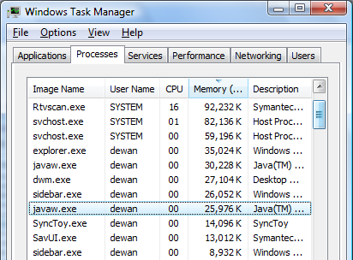
Interleaved Processes
Process is an interleaved activity created by the Operating System each time a main method is run

Slide 25
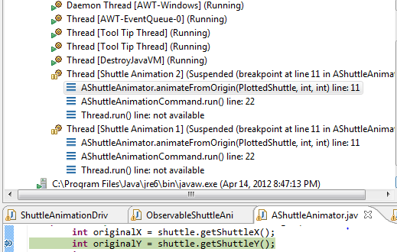
Interleaved Threads
PC of thread 2
Thread is an interleaved activity within a process.
Threads in a process work cooperatively to do the job of the process.
Java creates several threads when running our program for UI processing, garbage collection, main method, ….

Slide 26
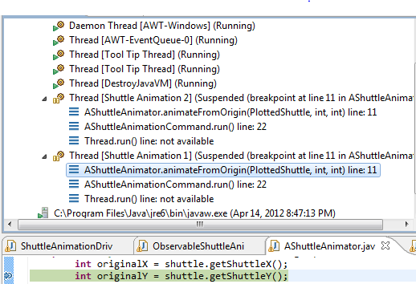
The Program Counter of Other Thread
PC of thread 1

Slide 27
Concurrent Activities
while (curY < originalY) {
ThreadSupport.sleep(animationPauseTime);
curY += animationStep;
shuttle.setShuttleY(curY);
}
while (curY < originalY) {
ThreadSupport.sleep(animationPauseTime);
curY += animationStep;
shuttle.setShuttleY(curY);
}

Slide 28
Concurrent Activities
while (curY < originalY) {
ThreadSupport.sleep(animationPauseTime);
curY += animationStep;
shuttle.setShuttleY(curY);
}
while (curY < originalY) {
ThreadSupport.sleep(animationPauseTime);
curY += animationStep;
shuttle.setShuttleY(curY);
}
On single-core, single-processor, a single processor/core interleaves their execution.
Processes/threads can execute concurrently in multi-processor, multi-core computers.

Slide 29

Concurrency in “Real” Life

Slide 30
Concurrency and Interleaving
while (curY < originalY) {
ThreadSupport.sleep(animationPauseTime);
curY += animationStep;
shuttle.setShuttleY(curY);
}
while (curY < originalY) {
ThreadSupport.sleep(animationPauseTime);
curY += animationStep;
shuttle.setShuttleY(curY);
}
while (curY < originalY) {
ThreadSupport.sleep(animationPauseTime);
curY += animationStep;
shuttle.setShuttleY(curY);
}

Slide 31
Concurrency and Interleaving
while (curY < originalY) {
ThreadSupport.sleep(animationPauseTime);
curY += animationStep;
shuttle.setShuttleY(curY);
}
while (curY < originalY) {
ThreadSupport.sleep(animationPauseTime);
curY += animationStep;
shuttle.setShuttleY(curY);
}
while (curY < originalY) {
ThreadSupport.sleep(animationPauseTime);
curY += animationStep;
shuttle.setShuttleY(curY);
}

Slide 32
Concurrency and Interleaving
while (curY < originalY) {
ThreadSupport.sleep(animationPauseTime);
curY += animationStep;
shuttle.setShuttleY(curY);
}
while (curY < originalY) {
ThreadSupport.sleep(animationPauseTime);
curY += animationStep;
shuttle.setShuttleY(curY);
}
while (curY < originalY) {
ThreadSupport.sleep(animationPauseTime);
curY += animationStep;
shuttle.setShuttleY(curY);
}

Slide 33

Concurrency And Interleaving
Two hands serving three balls ~ two cores serving three threads.
While a ball is the air the other balls can be served ~ while a thread is waiting for user input or sleeping, others can be served.

Slide 34
Interleaving Activities
Each interleaved activity is associated with its own program counter, which marks the next statement to be executed for that activity.
At any one time, a single CPU executes the statement of only one activity called the current activity.
The CPU does not wait for the current activity to complete before switching to another activity.
How should we create a separate thread to execute animateFromOrigin?
Java creates the threads.
Requires us to tell it what method to execute.

Slide 35
Independent Animations?
public static void main(String[] args) {
PlottedShuttle shuttle1 = new AnObservablePlottedShuttle(50, 100);
OEFrame oeFrame1 = ObjectEditor.edit(shuttle1);
oeFrame1.hideMainPanel();
oeFrame1.setLocation(0, 0);
oeFrame1.setSize(400, 400);
PlottedShuttle shuttle2 = new AnObservablePlottedShuttle(100, 50);
OEFrame oeFrame2 = ObjectEditor.edit(shuttle2);
oeFrame2.hideMainPanel();
oeFrame2.setLocation(400, 0);
oeFrame2.setSize(400, 400);
ShuttleAnimator shuttleAnimator1 = new AShuttleAnimator();
ShuttleAnimator shuttleAnimator2 = new AShuttleAnimator();
shuttleAnimator1.animateFromOrigin(shuttle1, 5, 100);
shuttleAnimator2.animateFromOrigin(shuttle2, 5, 100);
}
Second animation waits for first one to finish
How to get two threads

Slide 36
Thread Object
Thread
Thread
start()
suspend()
resume()
changePriority()
interrupt()
A thread is an object that can be started., suspended, resumed, interrupted while sleeping, given lower/higher priority …
How to create a startable thread?

Slide 37
Thread Object (Review)
Thread
Thread
start()
suspend()
resume()
changePriority()
interrupt()
A thread is an object that can be started., suspended, resumed, interrupted while sleeping, given lower/higher priority …
How to create a startable thread?

Slide 38
Independent Animations?
public static void main(String[] args) {
PlottedShuttle shuttle1 = new AnObservablePlottedShuttle(50, 100);
OEFrame oeFrame1 = ObjectEditor.edit(shuttle1);
oeFrame1.hideMainPanel();
oeFrame1.setLocation(0, 0);
oeFrame1.setSize(400, 400);
PlottedShuttle shuttle2 = new AnObservablePlottedShuttle(100, 50);
OEFrame oeFrame2 = ObjectEditor.edit(shuttle2);
oeFrame2.hideMainPanel();
oeFrame2.setLocation(400, 0);
oeFrame2.setSize(400, 400);
ShuttleAnimator shuttleAnimator1 = new AShuttleAnimator();
ShuttleAnimator shuttleAnimator2 = new AShuttleAnimator();
shuttleAnimator1.animateFromOrigin(shuttle1, 5, 100);
shuttleAnimator2.animateFromOrigin(shuttle2, 5, 100);
}
Second animation waits for first one to finish
Need multitasking

Slide 39
Predefined Main Thread
APlotted
Shuttle
APlotted
Shuttle
setShuttleX(Y)()
setShuttleX(Y)()
AShuttleAnimator
animate Shuttle()
AShuttleAnimator
animate Shuttle()
How to specify a method as a parameter?
Main Thread
Main Class
main
start()
Each thread has a stack of method calls
Creating a new thread means asking a Thread object to create a new stack so no blocking occurs
A call to a method M² by M¹ gets pushed on top of the call to M¹ which blocks
→ Must specify to (the constructor of) the Thread object the first method call in the stack (method + parameters + object)
The call to M² is popped when it returns, allowing M¹ to continue

Slide 40
Action Object (Method Object)
Action Object (Method Object)
execute (targetObject, params)
Provides an execute operation to perform some action.
A method that does not take method objects as arguments is a first-order function
The execute operation takes as an argument the object on which the target operation is to invoked and an array of parameters of the target action.
A method that takes as an argument a method object is a second (higher) order function.
A method that takes as an argument an N-order method object is an N+1 order method
Can pass to a constructor a method object.
Java reflection supports higher order functions

Slide 41
Using Reflection to Create Thread Object
public static void demoShuttleAnimation(
ShuttleAnimator aShuttleAnimator, PlottedShuttle aShuttle) {
aShuttleAnimator.animateFromOrigin(aShuttle, 5, 100);
}
public static void concurrentDemoShuttleAnimation(
ShuttleAnimator aShuttleAnimator, PlottedShuttle aShuttle) {
Thread thread = new Thread(aShuttleAnimator,
animateFromOriginMethod, new Object[] {aShuttle, 5, 100});
threadNumber++;
thread.setName(SHUTTLE_THREAD_NAME + " " + threadNumber);
thread.start();
}
Reflection allows method parameters
Exceptions can be thrown because a method can be invoked on an arbitrary object with arbitrary parameters
A la grammar/vocabulary vs. phrase book

Slide 42
Action vs. Command
public static void demoShuttleAnimation(
ShuttleAnimator aShuttleAnimator, PlottedShuttle aShuttle) {
aShuttleAnimator.animateFromOrigin(aShuttle, 5, 100);
}
public static void concurrentDemoShuttleAnimation(
ShuttleAnimator aShuttleAnimator, PlottedShuttle aShuttle) {
Thread thread = new Thread
(new AShuttleAnimationCommand
(aShuttleAnimator, aShuttle, 5, 100));
threadNumber++;
thread.setName(SHUTTLE_THREAD_NAME + " " + threadNumber);
thread.start();
}
Bundle the target object and the three arguments into a single command object associated with some action
The constructor of the command object checks that the target and parameters are compatible with its action

Slide 43
ActionObject (Method Object)
Action Object (Method Object)
execute (targetObject, params)
Use an object in which the action, target and params are bundled together

Slide 44
Command Object (Method Object)
Action Object (Method Object)
Commmand (action with target + parameters)
execute ()
execute (targetObject, params)
Constructor (targetObject, params)
Provides a execute operation to perform some action.
Constructor takes target object and parameters of operation as arguments.
Action is an operation that can be invoked on many different arguments
The execute operation takes no arguments.
A command is a specific action invocation.
Action vs. command object ←→ “do” vs “Bob, do your homework”
Action vs. command object ←→ “move” vs “move Arthur 50 30”

Slide 45
Java Thread Command Object
Action Object (Method Object)
Commmand (action + target + parameters)
run ()
execute (targetObject, params)
Constructor (targetObject, params)
IS-A
package java.lang;
public interface Runnable {
public void run();
}
The interface is called Runnable instead of Command and the method is called run() instead of execute() because Thread designers probably did not realize they were using a command object
The command object like an observable, model, view is a general design object that occurs in several contexts and was invented in the context of undo

Slide 46
Runnable Implementation
public class AShuttleAnimationCommand implements Runnable {
ShuttleAnimator shuttleAnimator;
PlottedShuttle shuttle;
int animationStep;
int animationPauseTime;
public AShuttleAnimationCommand (
ShuttleAnimator aShuttleAnimator,
PlottedShuttle aShuttle,
int anAnimationStep,
int anAnimationPauseTime) {
shuttleAnimator = aShuttleAnimator;
shuttle = aShuttle;
animationStep = anAnimationStep;
animationPauseTime = anAnimationPauseTime;
}
public void run() {
shuttleAnimator.animateFromOrigin(shuttle,
animationStep, animationPauseTime);
}
}
Action is hardwired: Separate implementation of Command Object Interface for each action
Action
Parameters
Target Object

Slide 47
Tracing Command Object
public static void demoShuttleAnimation(
ShuttleAnimator aShuttleAnimator, PlottedShuttle aShuttle) {
aShuttleAnimator.animateFromOrigin(aShuttle, 5, 100);
}
public static void concurrentDemoShuttleAnimation(
ShuttleAnimator aShuttleAnimator, PlottedShuttle aShuttle) {
Thread thread = new Thread(new AShuttleAnimationCommand
(aShuttleAnimator, aShuttle, 5, 100));
threadNumber++;
thread.setName(SHUTTLE_THREAD_NAME + " " + threadNumber);
thread.start();
}
Creates a new Command
Starts the thread, which Invokes the run method on the command object passed to constructor.
Creates a new Java thread
The run method calls animateFromoOigin() on target object

Slide 48
Two Shuttles and Animators, Two Threads
APlotted
Shuttle
APlotted
Shuttle
setShuttleX(Y)()
setShuttleX(Y)()
AShuttleAnimator
animate Shuttle()
AShuttleAnimator
animate Shuttle()
AShuttleAnimation Command
AShuttleAnimation Command
run()
run()
Thread
Thread
start()
start()
Main Thread
Main Class
start()
main()

Slide 49
Synchronous/Asynchronous Method Call
public static void demoShuttleAnimation(
ShuttleAnimator aShuttleAnimator, PlottedShuttle aShuttle) {
aShuttleAnimator.animateFromOrigin(aShuttle, 5, 100);
System.out.println(“animation finished”);
}
public static void concurrentDemoShuttleAnimation(
ShuttleAnimator aShuttleAnimator, PlottedShuttle aShuttle) {
Thread thread = new Thread(new AShuttleAnimationCommand
(aShuttleAnimator, aShuttle, 5, 100));
threadNumber++;
thread.setName(SHUTTLE_THREAD_NAME + " " + threadNumber);
thread.start();
System.out.println(“animation finished”);
}
Method caller waits for called method to finish.
Thread creator does not wait for created thread to finish.
Thread creation is typically the last step in a method call chain, so thread creator will probably be gone by the time the started thread eecutes

Slide 50
Synchronous vs. Asynchronous
operation(<parms>)
animateFromOrigin();
System.out.println(“hello”)
Synchronous: Operation invoker blocks or waits until the operation finishes
Asynchronous: Operation invoker does not block until completion
Some other operation (e.g. observer notification) needed to wait for result or completion status

Slide 51
Synchronous/Asynchronous Analogy
Synchronous
I ask you a question in class and wait for answer.
I order food at subway and wait till my sandwich is made
Asynchronous
I give you the question as home work.
I order food at a fancier restaurant with waiters.

Slide 52
Command Design Pattern
AnObservablePlotted
Shuttle
setShuttleX(Y)()
Command object: Defines an execute method
AShuttleAnimator
animate Shuttle()
Command invoker: invokes the execute method of a command object
AShuttleAnimation Command
run()
Command Client: Instantiates the command object
Thread
start()
Main Class
main()

Slide 53
Thread-based Animation Design Pattern
AnObservablePlotted
Shuttle
setShuttleX(Y)()
Animated object: performs each animation step, unaware of the animation
Animating object: Implements looping animation methods that take as parameters the animated object and optional animation controls
AShuttleAnimator
animate Shuttle()
Animating command object: Its execute method calls an animating method in an animating object with parameters of the method. Constructor takes as parameters the animating object, animated object and animation controls.
AShuttleAnimation Command
run()
Thread
start()
Animating thread: Invoker of the execute method of an animating command object
Animating client: Client of an animating command object and creator and starter of an animating thread
Main Class
main()

Slide 54
Thread-based Animation Design Pattern
AnObservablePlotted
Shuttle
setShuttleX(Y)()
Animated object
AShuttleAnimator
animate Shuttle()
Animating object:
AShuttleAnimation Command
Animating command object
run()
Thread
Combine objects?
start()
Animating thread
Combine animated and animating object?
Animating client
Main Class
main()

Slide 55
Combine Animated and Animating?
AnObservablePlotted
Shuttle
setShuttleX(Y)()
Animated object
animate Shuttle()
Animating object:
AShuttleAnimation Command
Animating command object
run()
Thread
start()
Animating thread
Combine animated and animating object?
Animating client
Main Class
main()

Slide 56
Combinng Animated and Animating
AnotherPlotted
Shuttle
setShuttleX(Y)()
Animated object
Must duplicate animating code for AnotherPlottedShuttle
animate Shuttle()
Animating object:
AShuttleAnimation Command
Animating command object
run()
Thread
start()
Animating thread
Animating client
Main Class
main()

Slide 57
Thread-based Animation Design Pattern
AnObservablePlotted
Shuttle
setShuttleX(Y)()
Animated object
Original Code working with AnObservablePlotted
Shuttle
AShuttleAnimator
animate Shuttle()
Animating object:
AShuttleAnimation Command
Animating command object
run()
Thread
start()
Animating thread
Animating client
Main Class
main()

Slide 58
Thread-based Animation Design Pattern
AnotherPlotted
Shuttle
setShuttleX(Y)()
Animated object
Reusing animating code for AnotherPlottedShuttle
AShuttleAnimator
animate Shuttle()
Animating object:
Animating command object
AShuttleAnimation Command
run()
Thread
start()
Animating thread
Animating client
Main Class
main()

Slide 59
Thread-based Animation Design Pattern
AnotherPlotted
Shuttle
setShuttleX(Y)()
Animated object
Using a different animator for same animated object
AnotherShuttle Animator
animate Shuttle()
Animating object
Animating command object
AShuttleAnimation Command
Combine animating object and command?
run()
Thread
start()
Animating thread
Animating client
Main Class
main()

Slide 60
Combine Animator and Command?
AnObservablePlotted
Shuttle
setShuttleX(Y)()
Animated object
animate Shuttle Backwards()
AShuttleAnimator
animate Shuttle()
Animating object:
May want forward and backward animation in one object
Animating command object
run()
Or may want to run animation synchronously
Shuttle Animation Thread 1
start()
Animating thread
Run executes asynchronously exactly one method
Animating client
Main Class
main()

Slide 61
Thread-based Animation Design Pattern
AnotherPlotted
Shuttle
setShuttleX(Y)()
Animated object
animate Shuttle Backwards()
AShuttleAnimator
animate Shuttle()
Animating object:
AnotherShuttleAnimation Command
AShuttleAnimation Command
Animating command object
run()
run()
Thread
start()
Animating thread
Our pattern allows a separate command object to be created for each method of an object that is to be executed asynchronously
Animating client
Main Class
main()

Slide 62
Subclass Thread?
Subclass Thread rather than give it a constructor argument
AnObservablePlotted
Shuttle
setShuttleX(Y)()
Animated object
AShuttleAnimator
animate Shuttle()
Animating object:
AnAnimating Command
IS-A
AShuttleAnimation Command
Animating command object
run()
A command is executed by a thread and is not a thread!
IS-A
run()
Thread
start()
Animating thread
Subclassed thread cannot inherit from another class
Animating client
Main Class
main()

Slide 63
Inheritance Among Command Objects
AnObservablePlotted
Shuttle
setShuttleX(Y)()
Animated object
AShuttleAnimator
animate Shuttle()
Animating object:
AnAnimating Command
IS-A
AShuttleAnimation Command
Animating command object
run()
run()
Our pattern allows inheritance among Command objects
Thread
start()
Animating thread
Animating client
Main Class
main()

Slide 64
Abusing IS-A and Instantiating Unnecessary Code
AnObservablePlotted
Shuttle
setShuttleX(Y)()
Animated object
AShuttleAnimator
animate Shuttle()
Animating object:
Parser/Undoer
AShuttleAnimation Command
Animating command object
HAS-A
run()
Other objects such as parser and undoer might need to share a thread command objects
IS-A
run()
Thread
start()
Animating thread
Unnecessary run code in these classes if we combine thread with command object
Animating client
Main Class
main()

Slide 65
Not instantiating Unnecessary Code
AnObservablePlotted
Shuttle
setShuttleX(Y)()
Animated object
AShuttleAnimator
animate Shuttle()
Animating object:
Parser/Undoer
AShuttleAnimation Command
Animating command object
HAS-A
run()
No instantiation of un-necessary Thread code using our pattern
run()
Thread
start()
Animating thread
Animating client
Main Class
main()

Slide 66
Command Objects vs. Threads
Threads can use command objects
Command objects can be used in non thread contexts
Undo/redo
Processing command interpreter commands

Slide 67
Threads
If we want multiple animations then we must create our own threads
Threads use command objects.
Command objects represent method calls

Slide 68
Animation Pattern
Begin with the object to be animated
Write one or more animating object with one or more looping methods to animate the animated object that take animation controls as arguments
Write one or more implementations of Runnable, each of which takes the animation controls and the above two objects as parameters and calls a looping method of the animating objects
In the main program or some model method, create one or more Thread instace, passing to the Thread constructor an instance of the Runnable command object.
Execute the start() method on each Thread instance.

